Slide 1
Special Session – Narration in Writing
Wednesday, November 18
Hello, everyone! We do not meet in the classroom today. This presentation file will guide you to complete the lecture in
self-paced mode. I will be available on zoom for lecture explanation (see next slide for zoom availability.) I’ve added a bonus assignment based on this lecture. You may find the bonus questions in the following slides.

Slide 2
Today’s Lecture Mode
This is a silent/annotated lecture.
Annotations:
If you wish to speak to me or have the lecture via zoom, I’ll be available via zoom (zoom id: 9098694052) 10-11:50am and your regular class meeting time.
Appreciate it if you could drop me an email before joining the zoom as I may be on another zoom with student appointments etc.
I’ve put whatever I’d talk during the face-to-face meeting in writing and placed in curve-shaped blocks or highlighted.

Slide 3
With your strong background in Java, I am confident that you’re familiar with exception handling. This lecture focuses on comparisons of language constructs in supporting exception handling.
Lecture 10: Exception Handling
Basic concepts
and
summary of features

Slide 4
Basic Concepts
Exception vs. Errors
Error: unrecoverable, e.g. OutOfMemoryError
Exception: unexpected event that can be handled gracefully, e.g. FileNotFoundException
– Are exceptions all bad? (not necessary)
We can apply exception handling constructs to check and prevent index bounds or zero-division case (similar to if-stmt does in these cases but in better structured way or with better readability.)

Slide 5
Basic Concepts
Exception handling vs. Event handling
Exceptions: entities that are generated by a condition or event and that might require additional information or investigation.
Events: completion or failure of some actions, indicating a user is interacting with a program.
Example: an event can be a mouse click or pressing a key on the keyboard.
Event handler: what to do when an event occurs
Event handling is a newer (exciting, useful) feature, but we won’t cover it in this class.

Slide 6
How did programmers survive at early days when there wasn’t any language supported exception handling mechanism?
(The following slides are based on my personal experience.)

Slide 7
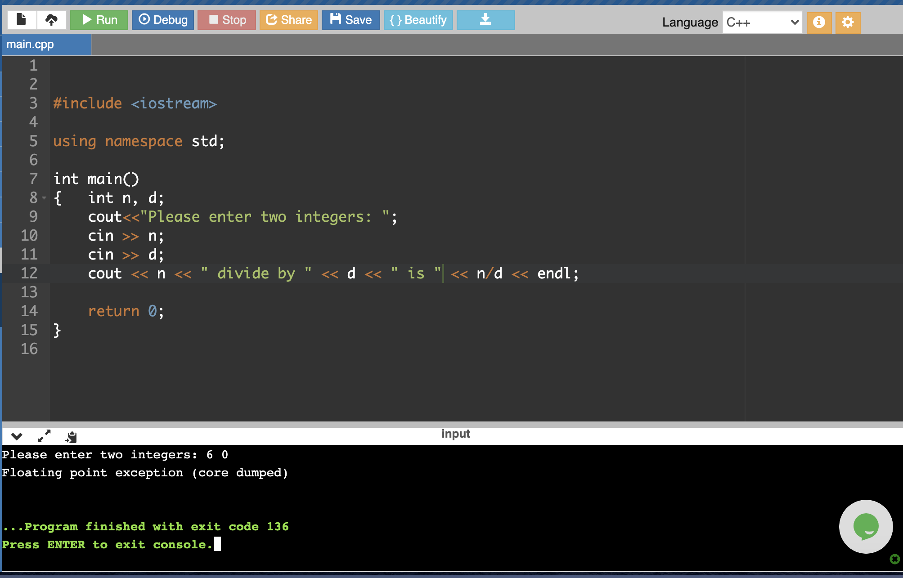
Scenario 1: When an exception occurs, control goes to OS where error msg displayed and program terminated
C++: Divide by zero exception(core dumped was a puzzled error message.)

Slide 8
Scenario 2: Programmer adds protection
if (d == 0 )
cout << “divide by zero error\n”;
else
cout << “quotient is: “ << n/d << “\n”;
cout << “now we continue”;
Compare with previous case, now in case d is 0, a message is displayed, and the program will continue to execute.
However, in this case the coding writability suffers (as well as readability) due to adding a lot of if statements to prevent exceptional cases.

Slide 9
Scenario 3: Aided with built-in function
//fin: a file stream opened successfully
while (!fin.eof()) { //while not end of file
data = fin.read();
…
}
!eof() protects read() from hitting an exception when no more data to read. Similar strategy could be used for preventing other exceptions such as file not exist when opening.
Without built-in functions such as eof(), programmers are not able to code the protection. – now these features are automatically built into exception handling mechanisms.

Slide 10
Scenario 4: errors occurred in subprograms
double my_div (double n, double d, int & flag) {
if (d == 0) {flag = 1; return 0.0; }
else { flag = 0; return n/d;}
}
int main () {
int error;
…
result = my_div (5, 0, error); //a status flag from the subprogram
if (error) { return 1; } else { … display result …}
…
}
A pass-by-reference parameter is used to keep track of whether an error every occurred or not.

Slide 11
Now, almost every newer language comes with language supported exception handling construct.
Language supported Exception handling mechanism became popular in 1980s. Java introduced it in its early version Java 1.0

Slide 12
Bonus Assignment
Question 1
True or False: If there is no exception handling mechanism in a language (say, there isn’t a try-catch block in Java), we have no way to protect our program from errors such as divide-by-zero or index out of bound.

Slide 13
Basic Concepts
What?
What is an exception?
What is an exception handler?
Why?
Reliability (pros)
(cons) ?
How?
How to raise an exception?
How to catch an exception?
What if not caught?
How to handle an exception?
Where to go once an exception is handled?
Terms and fundamental knowledge on exception handling, applying to any programming language.

Slide 14
Exception Handling: Advantages
Traditionally error detection code is tedious to write
Exception handling encourages programmers to consider many different possible errors
Exception propagation allows a high level of reuse of exception handling code
Advantages of exception handling mechanism:
improved writability (including reuse)
improved reliability

Slide 15
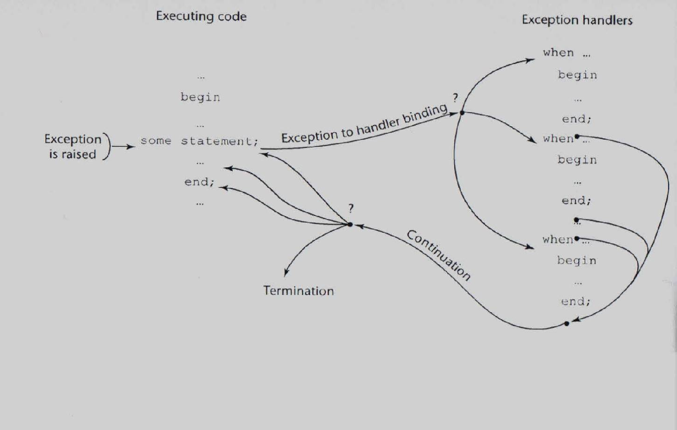
Exception Handling Control Flow

Slide 16
Bonus
Question 2
Why we introduce exception handling constructs to programming languages?
A. To enhance program’s readability
B. To enhance program’s reliability
C. To enhance program’s portability
D. To improve the run-time efficiency
Question 3
True or False
Most of the contemporary languages now included mechanisms for exception handling.
One reason that some languages do not include exception handling is the complexity it adds to the language.

Slide 17
Early Language Support: Ada
declare
A : Matrix (1 .. M, 1 .. N);
begin
for I in 1 .. M loop
for J in 1 .. N loop
begin
Get (A(I,J));
exception
when Data_Error =>
Put ("Ill-formed matrix element");
A(I,J) := 0.0;
end;
end loop;
end loop;
exception
when End_Error =>
Put ("Matrix element(s) missing");
end;
Ada is an early language with strong support to exception handling. Usage:
exception => when

Slide 18
Ada vs. C++ vs. Java
https://learn.adacore.com/courses/Ada_For_The_CPP_Java_Developer/chapters/10_Exceptions.html
For your reference only.

Slide 19
Exception Handling in C++
Added to C++ in 1990
Design is based on that of CLU, Ada, and ML
Exception Handlers Form:
try {
-- code that is expected to raise an exception
}
catch (formal parameter) {
-- handler code
}
...
catch (formal parameter) {
-- handler code
}
Ada’s except => when vs. C++’s try-catch, which design you like?

Slide 20
int main () {
…
cin >> a;
cin >> b;
try {
z = division(x, y);
cout << z << endl;
}
catch (const char* msg) {
cerr << msg << endl;
}
catch (double d) {
cerr << “not like” << d << ”as result”;
}
catch (…) { cerr << “other errors”; }
//e,g. error in cin >> a;
return 0;
}
double division(int a, int b) {
if( b == 0 ) {
throw ”Div by zero";
}
if (a == 0) {
throw 0.0;
return (a/b);
}
C++:
(1) any predefined exceptions ?
(2) throw exception, what type of values can be thrown?

Slide 21
Control Flow
If a throw statement is executed, control goes to the catch block
If a handler is matched, after a handler completes its execution, control flows to the first statement after the last handler in the sequence of handlers;
If no handler is matched, the exception is unhandled
Unhandled exceptions
An unhandled exception is propagated to the caller of the function in which it is raised
This propagation continues to the main function
If no handler is found, control goes to the OS (to call default exception handler provided by the OS)

Slide 22
Bonus
Question 4
The following function may have divide-by-zero errors during execution. However, within the function there is no exception handling code. What happens if y happens to be 0?
double divNum (double x, double y ) {return x/y; }
The program immediately crashes at the execution of x/y.
The exception will be passed to the function that calls divNum().
The function divNum will print out an error message before switching control flow to OS.
Correct answer not found in given choices.

Slide 23
Control Flow: Python vs. C++
Python: (1) advocate the use of predefined exceptions; (2) “else” feature in exception handling
try :
A
except myException :
B
else :
C
finally :
D
def divide(x, y):
try:
result = x / y
except ZeroDivisionError:
print("division by zero!")
else:
print("result is", result)
finally:
print("executing finally clause")
else block: executed when no exception occurs
finally block: always executed (popular in many languages)

Slide 24
Default handler: Python vs. C++
Python:
def divide(x, y):
try:
result = x / y
except ZeroDivisionError:
print("division by zero!")
except:
print(“Catch’em all!”)
else:
print("result is", result)
finally:
print("finally clause")
C++:
try {
z = division(x, y);
}
catch (…) { cerr << “other errors”; }
return 0;
}
What is Java’s default handler?

Slide 25
Bonus
Question 5
Which of the following is C++’s default exception handler (i.e. catch all handler)?
A. catch ( Exception e)
B. catch ()
C. catch (…)
D. catch ( _ )
E. None of above

Slide 26
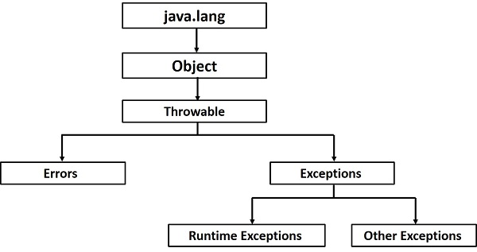
Java’s exception handling hierarchy
Is it good idea to have a root class for exceptions?
Reference

Slide 27
Checked and Unchecked Exceptions
Unchecked Exceptions
Exceptions of class Error and RunTimeException and all of their descendants (all others are checked exceptions)
Checked Exceptions
Checked exceptions are checked at compile-time.
It means if a method is throwing a checked exception then it should handle the exception using try-catch block or it should declare the exception using throws keyword, otherwise the program will give a compilation error.
throw vs. throws (Example next slide)
A method that calls a method with a particular checked exception in its throws clause has three alternatives:
Catch and handle the exception
Catch the exception and re-throw an exception (could be a different exception) listed in its own throws clause
Declare the same exception in its throws clause and do not handle it

Slide 28
Checked and Unchecked Exceptions
Unchecked Exceptions
Exceptions of class Error and RunTimeException and all of their descendants (all others are checked exceptions)
Checked Exceptions
Checked exceptions are checked at compile-time.
It means if a method is throwing a checked exception then it should handle the exception using try-catch block or it should declare the exception using throws keyword, otherwise the program will give a compilation error.
throw vs. throws (Example next slide)
A method that calls a method with a particular checked exception in its throws clause has three alternatives:
Catch and handle the exception
Catch the exception and re-throw an exception (could be a different exception) listed in its own throws clause
Declare the same exception in its throws clause and do not handle it
Are these good language features? Would you promote them (i.e. checked and unchecked exceptions and/or the usage of throw and throws) to future/new language design?

Slide 29
throw vs. throws
void myMethod() {
try {
//throwing arithmetic exception using throw
throw new ArithmeticException("Something went wrong!!");
}
catch (Exception exp) {
System.out.println("Error: "+exp.getMessage());
}
}
class Example {
public static void main(String args[]) throws IOException
{ //IOException will not be handled in main()
FileInputStream fis = null;
fis = new FileInputStream("B:/myfile.txt");
…
fis.close();
}

Slide 30
Bonus
Question 6
True or False
In Java, index out of bound exception is a checked exception
In Java, file not found exception is a unchecked exception.
Question 7
In your opinion, what are pros and cons of Java’s design of checked/unchecked exceptions. (use your own words to describe.)

Slide 31
Bonus
Question 8
True or False
In C++, a user-defined exception type must inherit from the Exception class.
In Java, any user-defined exception type is a descent of the Throwable class.

Slide 32
The finally Clause
class TestFinallyBlock{
public static void main(String args[]) {
try {
int data=25/5;
System.out.println(data);
}
catch(NullPointerException e) {
System.out.println(e);
}
finally {
System.out.println(”always executed");
}
System.out.println("rest of the code...");
} //end of main
} //end of class
Can appear at the end of a try construct
finally {
...
}
Purpose: To specify code that is to be executed, regardless of what happens in the try construct
newer languages all support the finally feature

Slide 33
Bonus
Question 9
Any problem with the use of finally in the pseudo code below?
try {
fn = … open a file
… read in data from the file …
}
catch ( … file not found error… ) {
… display the message
}
finally {
…close the file …
}

Slide 34
Bonus
Question 10
In the following Python’s code, what is the rule of the else?
if x > y :
try:
result = x // y
except ZeroDivisionError:
print("Sorry ! You are dividing by zero ")
else:
print("Yeah ! ")

Slide 35
Summary
Instead of looking back, I’d suggest that you look at the exception handling mechanism supported by your group language.
History
Ada, one of the first languages with comprehensive exception handling features, provides extensive exception-handling facilities with a large set of built-in exceptions.
C++ includes no predefined exceptions
Exceptions are bound to handlers by connecting the type of expression in the throw statement to that of the formal parameter of the catch function
Other features: the use of finally (and Python’s else), default handler, user-defined exceptions, etc.
My believe: Python well illustrated the convenience of using pre-defined exceptions
Similar to the switch statement’s matching

Slide 36
Well, we’ve finished Lecture 10: Exception Handling.
To earn extra credit, please complete the Bonus assignment on Canvas.
For the remaining time:
Take Quiz 5 – Coverage: OOPs (Lectures 8 and 9)
Work with group on Activity 5 and/or Capstone.
Thank you! Any question email me.
For zoom appointment please email me first before joining – zoom available today 10-11:50am as well as regular class meeting time.

